Slide 1
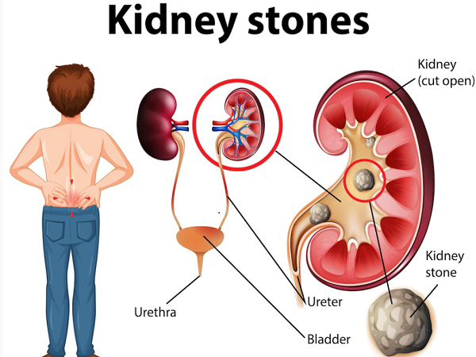

Slide 2
Uric Acid
Disclaimers:- This presentation is only for educational and awareness purpose. The speaker do not claim treatment of any diseases. If any one get relief from their physical challenges it’s their personal result. Individual results may vary.
Dr. Mahendra Ram
Wellness/Life/Career Coach
Assistant Professor, IIT Patna

Slide 3
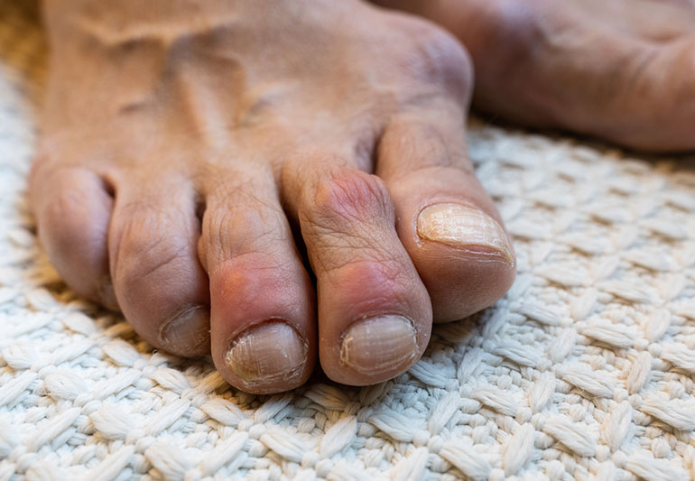
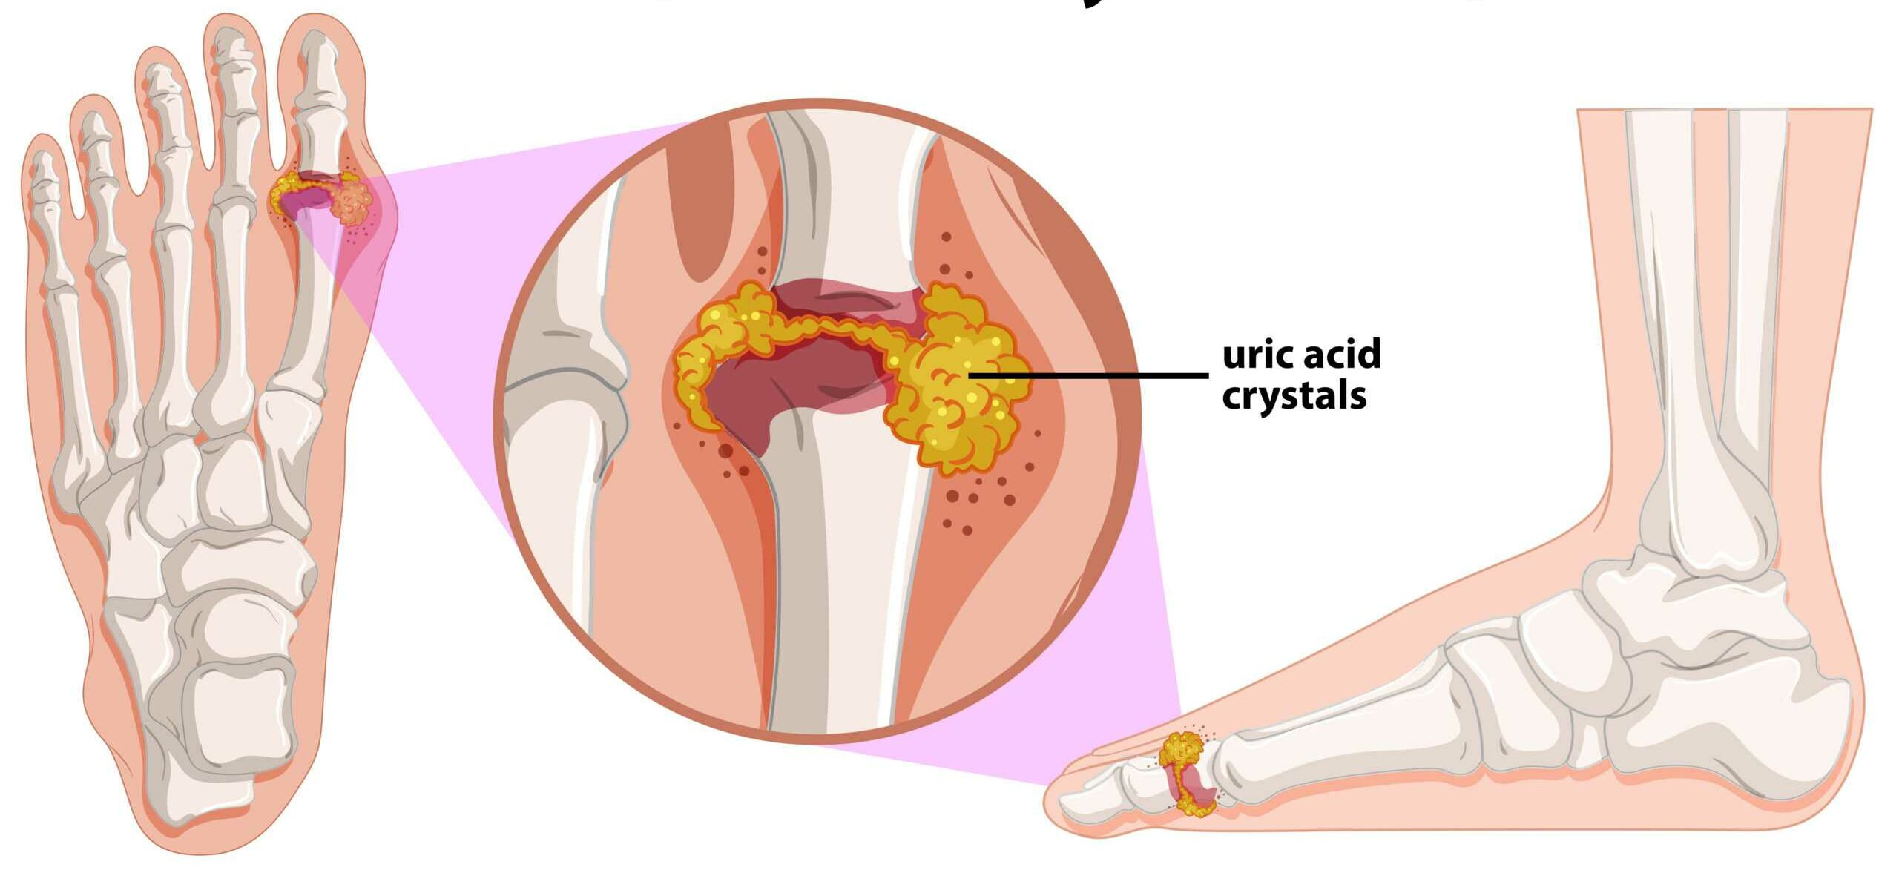

Slide 4
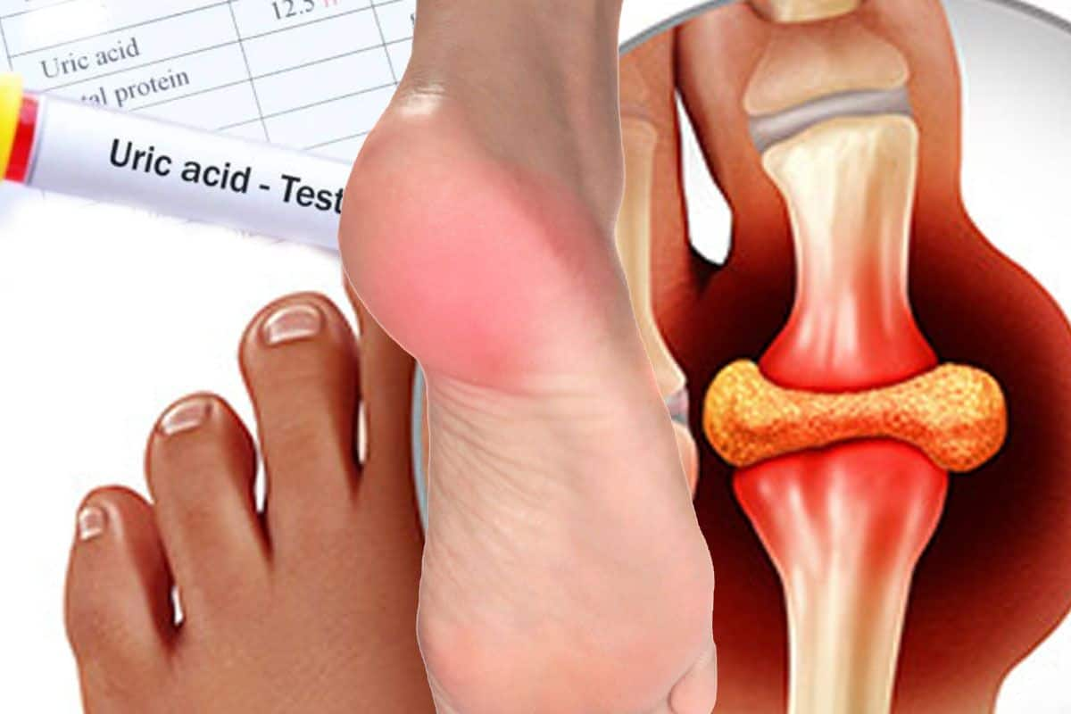

Slide 5
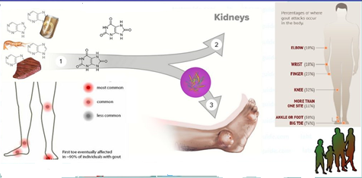
Uric acid is a chemical created when the body breaks down substances called purines.
Purines are normally produced in the body and are also found in some foods and drinks.
Foods with high content of purines include liver, anchovies, mackerel, dried beans and peas, and beer, red meat,
Most uric acid dissolves in blood and travels to the kidneys. From there, it passes out in urine.

Slide 6
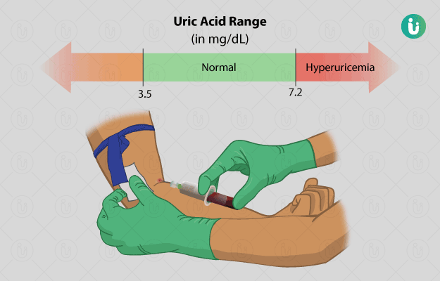
If your body produces too much uric acid or does not remove enough of it, you can get sick.
A high level of uric acid in the blood is called hyperuricemia.
Hyperuricemia can cause crystals of uric acid (or urate) to form.
These crystals can settle in the joints and cause gout, a form of arthritis that can be very painful.
They can also settle in the kidneys and form kidney stones.
If untreated, high uric acid levels may eventually lead to permanent bone, joint and tissue damage, kidney disease and heart disease.
Research has also shown a link between high uric acid levels and type 2 diabetes, high blood pressure, and fatty liver disease.

Slide 7
Purines and pyrimidines are two types of aromatic heterocyclic organic compounds. In other words, they are ring structures (aromatic) that contain nitrogen as well as carbon in the rings (heterocyclic). Both purines and pyrimidines are similar to the chemical structure of the organic molecule pyridine (C₅H₅N). Pyridine, in turn, is related to benzene (C₆H₆), except one of the carbon atoms is replaced by a nitrogen atom.
Purines and pyrimidines are important molecules in organic chemistry and biochemistry because they are the basis for other molecules (e.g., caffeine, theobromine, theophylline, thiamine) and because they are key components of the nucleic acids dexoyribonucleic acid (DNA) and ribonucleic acid (RNA).
Sourse: https://www.thoughtco.com/purines-and-pyrimidines-differences-4589943

Slide 8
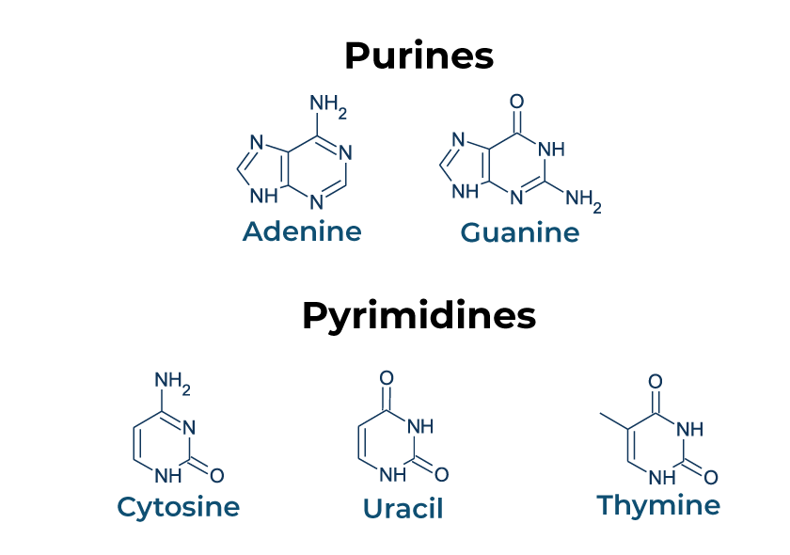

Slide 9
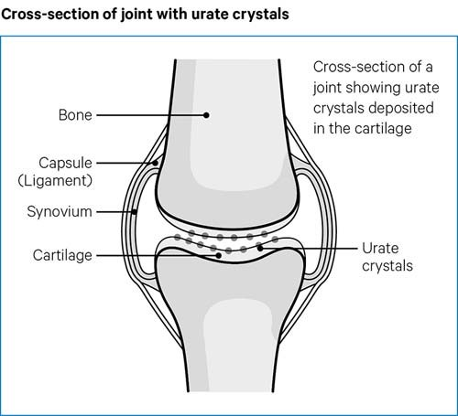
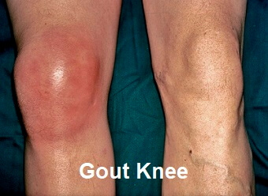
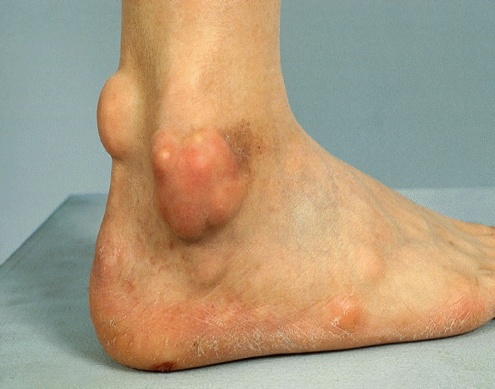
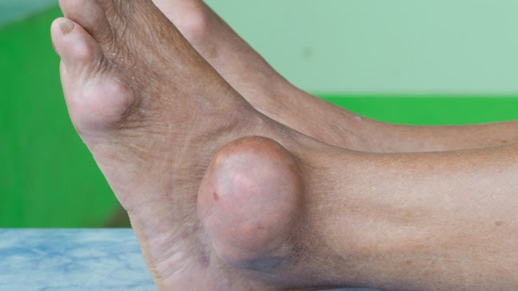

Slide 10
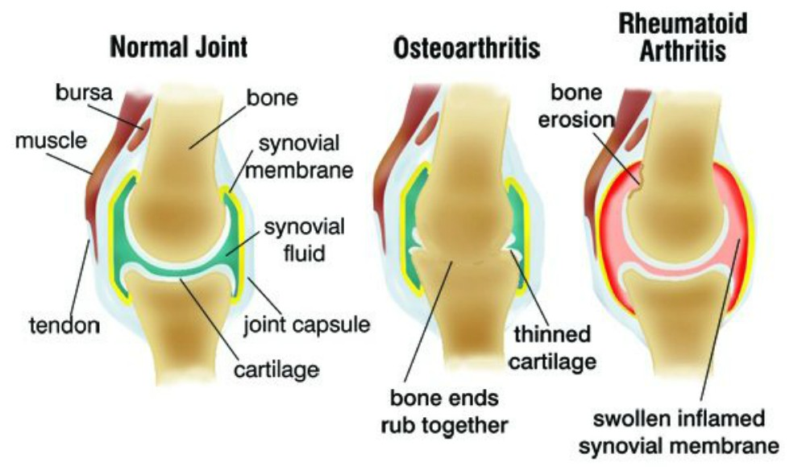

Slide 11
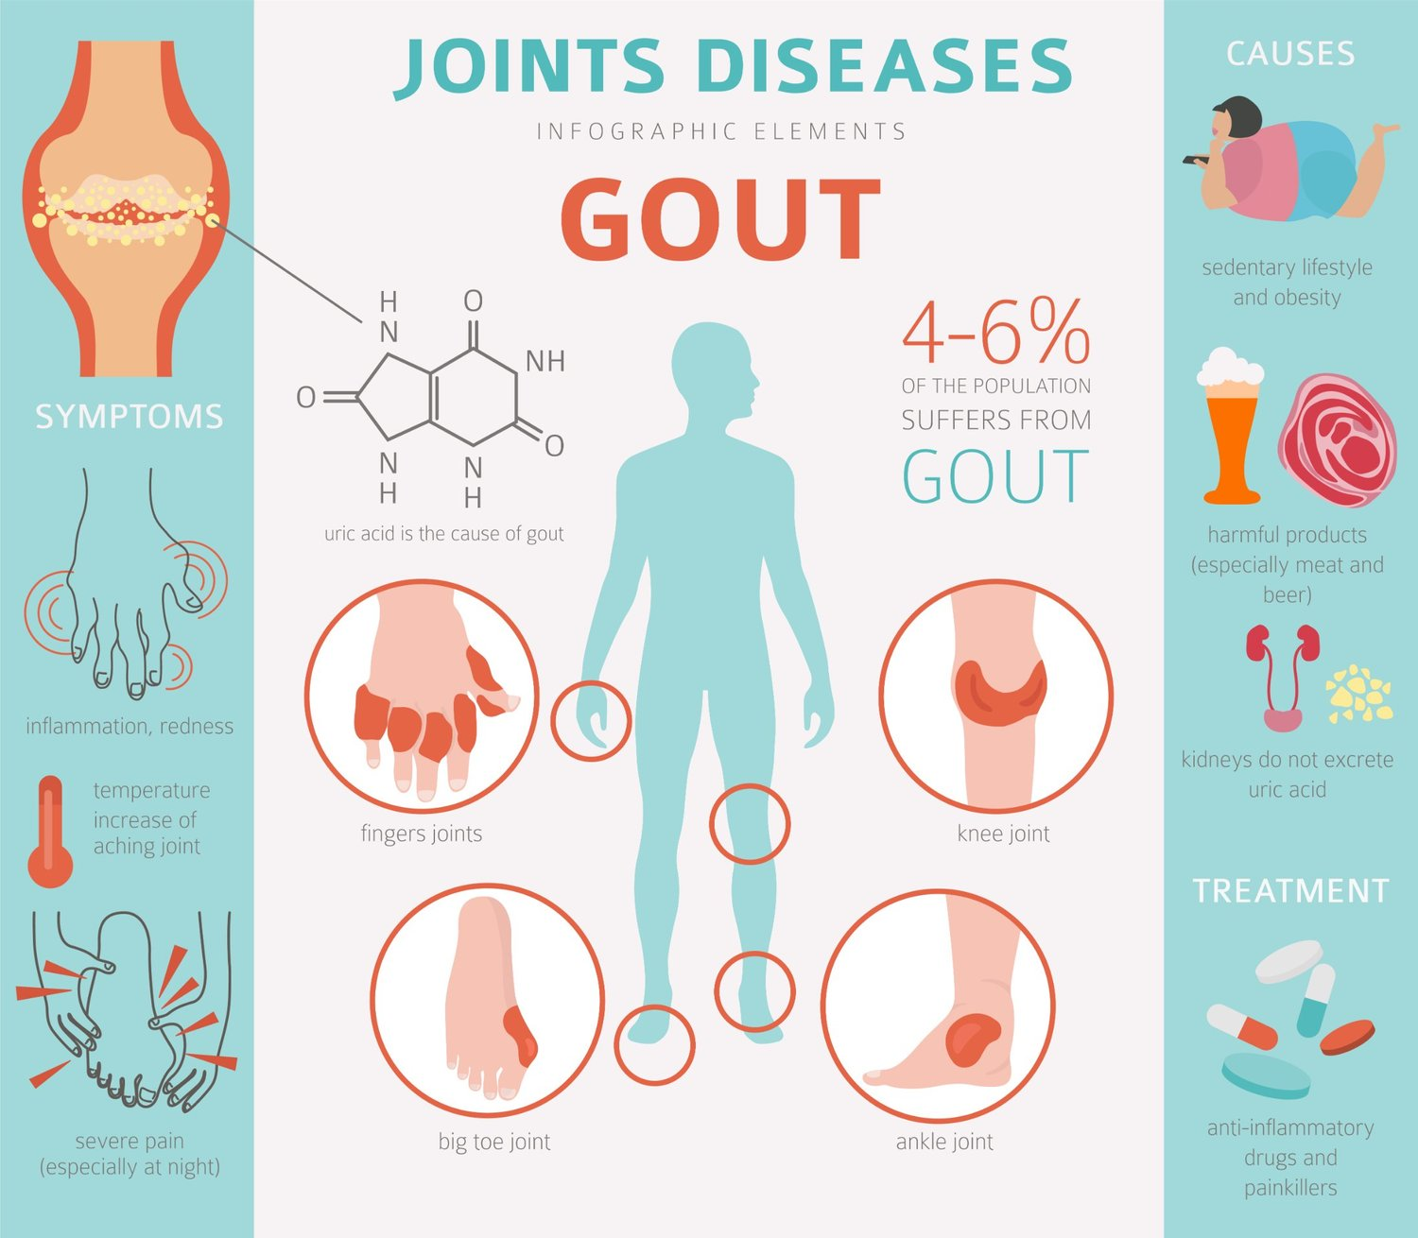

Slide 12
How is high uric level treated?
If you’re having a gout attack, medication can be used to reduce the inflammation, pain and swelling. You should drink plenty of fluids, but avoid alcohol and sweet soft drinks. Ice and elevation are helpful.
Kidney stones may eventually pass out of the body in urine. Drinking more fluid is important. Try to drink at least 64 ounces daily (8 glasses at eight ounces each). Water is best.
Your healthcare provider may also prescribe medications that help stones pass by relaxing the muscles in the ureter, the duct that urine passes through to get from the kidney to the bladder.
If the stone is too large to pass, blocks the flow of urine or causes an infection, it might be necessary to surgically remove the stone.

Slide 13
Can high uric acid level be managed and prevented?
A long-term program of disease management can help regulate and even stop high uric acid levels and joint pain flare-ups. Doctors can prescribe medications that dissolve the deposits of uric acid crystals.
A lifelong urate-lowering therapy may be needed, with medications that prevent gout flares and ultimately dissolve crystals that are already in your body.
Other ways to help manage high uric acid levels include:
Losing weight, if necessary.
Watching what you eat (limit your intake of fructose corn syrup, organ meats, red meat, fish, and beverages containing alcohol).

Slide 14
What will happen when the uric acid will be low
Uric acid is also an antioxidant and low levels can result in oxidative stress and endothelial dysfunction, which can predispose to illnesses such as hypertension and diabetes.

Slide 15
formula of Glucosamine, Scutellaria root extract and minerals to help maintain healthy joint function and comfort
collagen type 2, a major components of cartilage, intervertebral discs, and the vitreous humor of the eye and are vital to the normal development of bones and teeth

Slide 16


